Slide 1
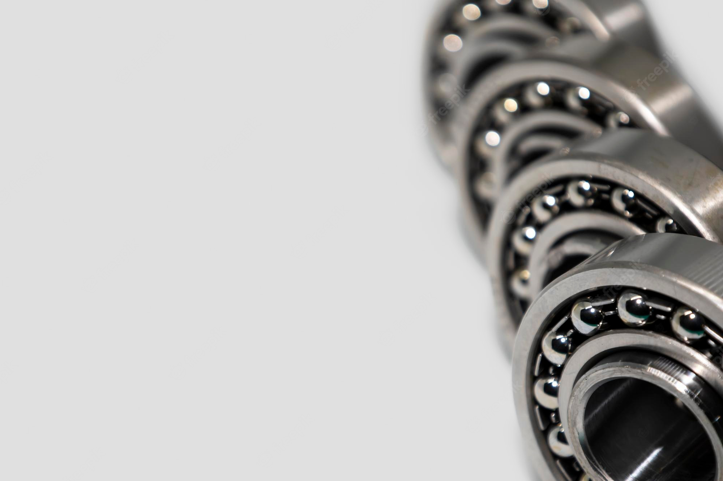
Senior Year Design Project 2022 - Progress Presentation
Advisor : Dr. Ahmad Abbas
Co-Advisor : Dr. Asif Khan

Slide 2
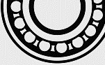




Group Members
Group 11
Shayan Malik
Sulaiman Tayyab
Muhammad Umar
2019371
2019502
2019388
2

Slide 3
DESIGN AND FABRICATION OF
(AI BASED) TEST BED FOR HEALTH ASSESSMENT OF DIFFERENT TYPES OF INDUSTRIAL BEARINGS
3

Slide 4
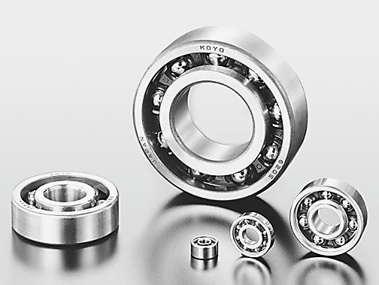
WHAT ARE BEARINGS ?
A bearing is a machine Element that constraints Relative motion and is used to reduce the friction between Moving parts of a Machine.
4

Slide 5
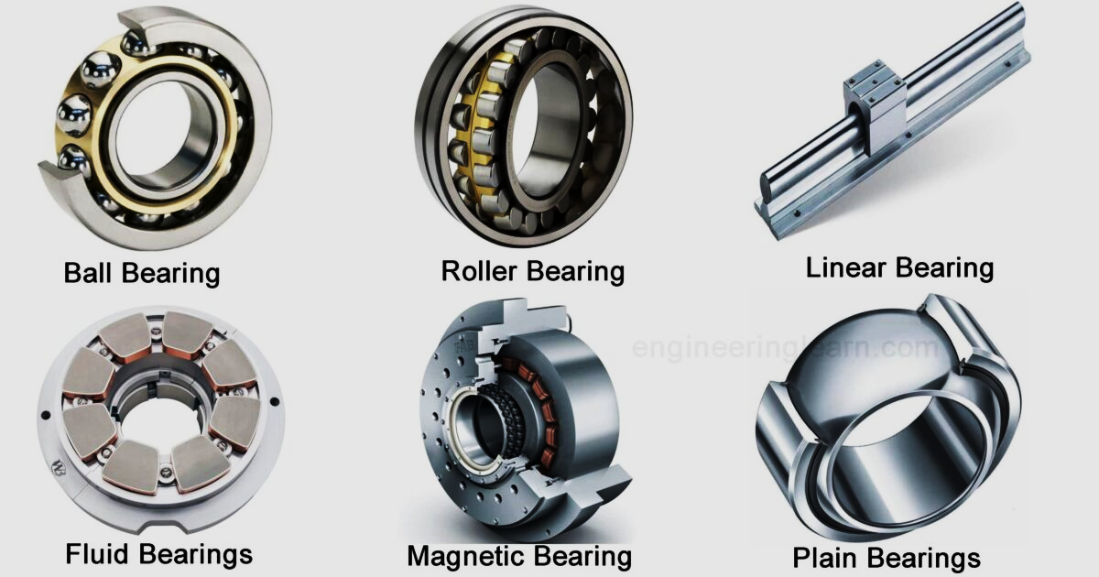
TYPES OF BEARINGS
5

Slide 6
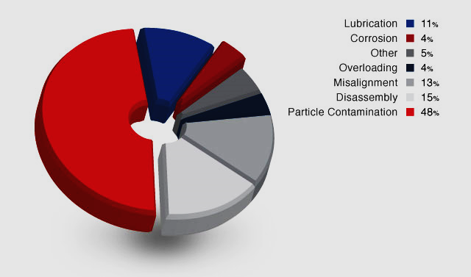
COMMON CAUSES OF BEARING FAILURE
6
https://www.cityseals.co.uk/products/bearing-protection/

Slide 7
FAULTS IN BEARINGS
Inner race fault
Outer race fault
seal breakage
rolling element fault
7

Slide 8
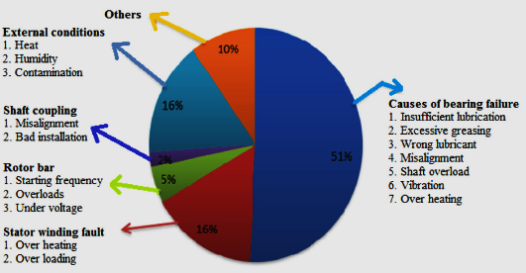
BACKGROUND AND MOTIVATION
Bearings are one of the most critical components of industrial machineries and manufacturing systems, Statistics show that about 51 % failures in induction motors, gearboxes and wind turbine are due to bearing failure. So our problem statement is to design a testbed for bearings using AI based system to evaluate the Bearing condition.
8

Slide 9
AIMS AND OBJECTIVES
Industrial bearings are susceptible to various types of faults that can ultimately result in the catastrophic failure of the entire system.
This project aims to design and fabricate a general-purpose test bed to obtain data from various types of industrial bearings in different health states and process it with artificial intelligence for the health conditions assessment of bearings.
The objective of this project is to design an AI based system that can evaluate the Bearing condition more effectively and accurately. The product will be commercialized, and a software/app could be developed later on that could analyze the bearings online.
9

Slide 10
LITERATURE REVIEW
S.NO | Bearing Type | Bearing Defect | Signal Type | Technique | Reference
1 | Ball Bearings | Inner Race Outer Race | Vibration Signals | Neural Network Using Genetic Algorithm | [1]
2 | Roller Bearings | Inner Race Outer Race Ball Defect | Vibration Signals | SVM KNN FKNN | [2]
3 | Ball Bearings | Outer Race | Vibration Signals | ANN | [3]
4 | Roller element Bearings | Inner Race Outer Race | Vibration Signals | KNN | [4]
5 | Roller element Bearings | Wear and Pitting | Wavelet Transform Vibration Signals | Deep Learning and Information Fusion | [5]
10

Slide 11
LITERATURE REVIEW
S.NO | Bearing Type | Bearing Defect | Signal Type | Technique | Reference
6 | Roller Bearings | Inner Race Outer Race Bearing Race | Vibration Signals | 1D-CNN (convolutional neural network) | [6]
7 | Ball Bearings | Inner Race Outer Race | Vibration Signals | ANN | [7]
8 | Roller bearings | Cage Inner Race Outer Race | Vibration Signals | SVM (support vector machine) | [8]
9 | Cylindrical Roller Bearings | Inner Race Outer Race Roller | Vibration Signals | KNN | [9]
10 | Ball Bearings | Inner Race Surface Ball with corrosion pitting | Vibration Signals | ANN SVM | [10]
11

Slide 12
TECHNIQUES FOR DETECTING
FAILURES
Motor current signal analysis (MCSA)
Acoustic signal analysis.
Vibration signal analysis.
Thermography.
12

Slide 13
AI Algorithms
Unsupervised Learning
Supervised Learning
Reinforcement Learning
Classification:
SVM
KNN
Random Forest
Decision Tree
Naive Bayesian
Regression:
Linear Regression
Logistic Regression
13

Slide 14
APPLICATION OF ARTIFICIAL
INTELLIGENCE
Support Vector Machine (SVM).
K Nearest Neighbors (KNN).
Naive Bayesian
Decision Tree
Random Forest
14

Slide 15
METHODOLOGY TO APPLY AI
Algorithm Selection & Application
Pre-processing and cleaning
Separation (training and testing set)
Sensors and Inspection Data
Event (Failure) Data
Environmental Data
(Including noise)
Fault Detection
Failure Analysis
Confidence Determination
Maintenance Decision Making
Data Acquisition
15
http://rpsonline.com.sg/proceedings/9789811127243/pdf/0188.pdf

Slide 16
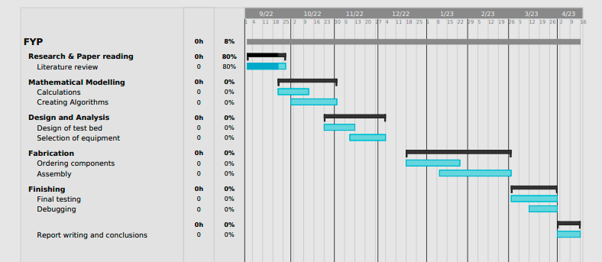
GANTT CHART
16

Slide 17
REFERENCES
[1 ] https://dl.acm.org/doi/10.1007/s13748-020-00217-z
[2] https://www.sciencedirect.com/science/article/pii/S235197892031893X
[3] https://ieeexplore.ieee.org/abstract/document/9182516
[4] https://link.springer.com/content/pdf/10.1155/S1110865704310085.pdf
[5] Current-Based Bearing Fault Diagnosis Using Deep Learning Algorithms by Andre S. Barcelos Et al.
[6] Bearing Fault Diagnosis Using Lightweight and Robust One-Dimensional Convolution Neural Network
in the Frequency Domain by Mohammed Hakim Et al.
[7] Bearing fault diagnostic using machine learning algorithms by Laith S. Sawaqed Et al.
[8] Gear and bearing fault classification under different load and speed by using Poincaré plot features
and SVM by Rubén Medina Et al.
[9] An Explainable AI-Based Fault Diagnosis Model for Bearings by Md Junayed Hasan Et al.
[10] Fault diagnosis of ball bearings using machine learning methods by P.K. Kankar
17

Slide 18
Thank you !
18

